Slide 1

Identifying Seizures With Brain Wave Data
By Arpit Bajpai

Slide 2

Background
Data Collected with EEG
EEGs are often run to determine when people are having seizures.
Seizures are difficult to detect
Electrodes detect brain activity.
A classifier that very accurately predicts whether a seizure happened or didn’t happen can assist in making the correct diagnosis.
For Example: Specialists use this brain activity to assist them in determining epilepsy.

Slide 3
Obtain:
We used the Epileptic Seizure Recognition Data Set
It tracked the brain wave activity of 500 different individuals over the course of 23 seconds.

Slide 4
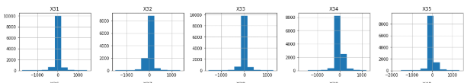
Exploring
Plotting our dataset shows us that the vast majority of points for most of our data lie near the mean.
This lets us know to go back and standardize the data so that we have more normal distributions to work with.
The fact that the data is anonymized made it much more difficult to get insights about specific independent variables.

Slide 5
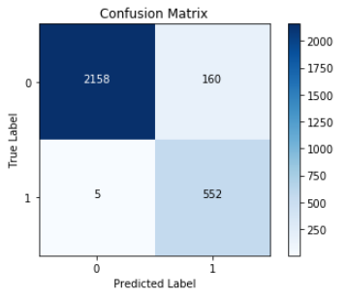
Modeling
Most Successful Model: Random Forest with Grid Search
Correctly predicts over 99% of all Seizures.

